Slide 1

Health Insurance Premium Prediction

Slide 2

Problem
An important informatics tool for controlling healthcare costs is to predict accurate insurance premium plan cost of individuals.

Slide 3


PROJECT OVERVIEW
The objective of this case study is to predict the health insurance cost incurred by Individuals based on their age, gender, BMI, number of children, smoking habit and geo-location.

Slide 4

PROJECT OVERVIEW
The available features are:
sex: insurance contractor gender
bmi: Body mass index (ideally 18.5 to 24.9)
children: Number of children covered by health insurance / Number of dependents
smoker: Smoking
region: the beneficiary's residential area in the US, northeast, southeast, southwest, northwest.
Target (output):
charges: Individual medical costs billed by health insurance
Data Source: https://www.kaggle.com/mirichoi0218/insurance

Slide 5




Our Solution
To build a web platform which predicts the health insurance cost incurred by Individuals based on various factors.
Use of Machine learning for prediction using factors such as age, gender, BMI, smoking habit, geo-location
Use of AWS cloud technologies for secure cloud storage
Integrated System that provides quick solution despite having complex computations

Slide 6

MULTIPLE LINEAR REGRESSION

Slide 7


MULTIPLE LINEAR REGRESSION: INTUITION
Multiple Linear Regression: examines relationship between more than two variables.
Recall that Simple Linear regression is a statistical model that examines linear relationship between two variables only.
Each independent variable has its own corresponding coefficient.
$$y=b_{0}+b_{1}∗x_{1}+b_{2}∗x_{2}+..+b_{n}x_{n}$$
DEPENDANT VARIABLES
INSURANCE COST ($)
INDEPENDENT VARIABLES
(AGE, SMOKING HABITS, REGION,..ETC)

Slide 8




Cloud Technologies
AWS S3 and IAM
AWS Lambda
AWS SageMaker
Amazon Simple Storage Service (Amazon S3) for cost effective storage with unmatched security, compliance, and audit capabilities
AWS Lambda, a serverless computing service, for continuous scaling and consistent performance at any scale
Amazon SageMaker, the most comprehensive ML service, to prepare, build, train, and deploy high-quality machine learning (ML) models quickly

Slide 9

Benefits of Cloud Technology
AGILITY
Instead of buying physical hardware and software and setting them up which takes month, cloud computing gives leverage of faster deployment .
ELASTICITY
Allows for scaling and shrinking resources based on demand
COST SAVINGS
Massive savings with economies of scale.
EASY DEPLOYMENT
Companies can deploy services in any corner of the planet in minutes by leveraging the cloud.

Slide 10
Assessing Model Performance

Slide 11


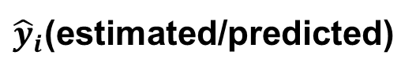
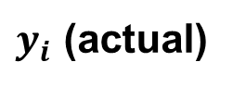
Regression Metrics:
How to Assess Model Performance ?
After model fitting, we would like to assess the performance of the model by comparing model predictions to actual (True) data
$y_{i}$ (actual)
$$Error$$
$$Residuals (Error)={\hat{y}}_{i}−y_{i}$$
INSURANCE COST ($)
${\hat{y}}_{i}$(estimated/predicted)
AGE (YEARS)

Slide 12

Regression Metrics: Mean Absolute Error (MAE)
REGRESSION METRICS: MEAN ABSOLUTE ERROR (MAE)
Mean Absolute Error (MAE) is obtained by calculating the absolute difference between the model predictions and the true (actual) values
MAE is a measure of the average magnitude of error generated by the regression model
The mean absolute error (MAE) is calculated as follows:
$$MAE=\frac{1}{n}\sum_{i=1}^{n}{|y_{i}−{\hat{y}}_{i}|}$$
MAE is calculated by following these steps:
Calculate the residual of every data point
Calculate the absolute value (to get rid of the sign)
Calculate the average of all residuals
If MAE is zero, this indicates that the model predictions are perfect.

Slide 13

Regression Metrics: Mean Square Error(MSE)
Mean Square Error (MSE) is very similar to the Mean Absolute Error (MAE) but instead of using absolute values, squares of the difference between the model predictions and the training dataset (true values) is being calculated.
MSE values are generally larger compared to the MAE since the residuals are being squared.
In case of data outliers, MSE will become much larger compared to MAE
In MSE, error increases in a quadratic fashion while the error increases in proportional fashion in MAE
In MSE, since the error is being squared, any predicting error is being heavily penalized
The MSE is calculated as follows:
$$MSE=\frac{1}{n}\sum_{i=1}^{n}{{\left(y_{i}−{\hat{y}}_{i}\right)}^{2}}$$
MSE is calculated by following these steps:
Calculate the residual for every data point
Calculate the squared value of the residuals
Calculate the average of results from step #2

Slide 14


Prototype (link)

Slide 15

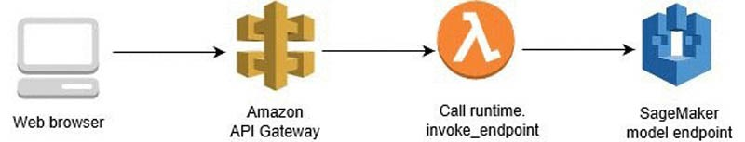
Architecture Diagram

Slide 16

Future Scope
We can include more relevant attributes which will increase the accuracy of the model and we can get more precise premium
We can make it more attractive and user friendly with better UI and integrate it with existing citi systems

Slide 17

Team Members
Rohit Kumar
Saurav Chaudhary
Vidushi Vigh
Rishu Kumar
THANK YOU!

